Slide 1

IBM SKILLSBUILD INTERNSHIP project
TOPIC: ANALYSIS OF SUPERSTORE DATASET
STUDENT DETAILS:
NAME: S.Bisakha
SKILLSBUILD EMAIL : s.bisakha008@gmail.com
COLLEGE NAME: C.V. Raman Global University
STATE: Odisha
INTERNSHIP DOMAIN: Data Analytics (DA)
INTERNSHIP period: 12/06/2023 – 24/07/2023
ORGANIZATION: DG

Slide 2
ANALYSIS OF SUPERSTORE DATASET
The project "Analysis of Superstore Dataset" aims to explore and analyze a dataset obtained from a fictional retail superstore. The dataset contains a wide range of information, such as sales, customer details, product categories, and geographical data. By conducting a comprehensive analysis, we intend to gain valuable insights into the store's performance, customer behavior, and potential areas for improvement.
Data Collection and Preprocessing: Collect and preprocess the Superstore dataset.
Sales Analysis: Analyze sales metrics, trends, and factors influencing sales fluctuations.
Customer Behavior Analysis: Study customer demographics, preferences, and segmentation for personalized strategies.
Exploratory Data Analysis (EDA): Perform exploratory analysis, including data distribution, outliers, and visualizations.
Operational Efficiency Analysis: Evaluate operational efficiency, identify bottlenecks, and optimize resource allocation.
Conclusion and Next Steps: Summarize findings, plan for advanced analysis, predictive modeling, and integration of external data sources.

Slide 3
AGENDA
S.NO | TOPIC NAME
1 | Project Review
2 | End Users of This Project
3 | My Solution and its Value Proposition
4 | Unique Aspects
5 | Modelling
6 | Results
7 | Links

Slide 4
PROJECT OVERVIEW
The project aims to conduct a comprehensive analysis of a fictional retail superstore's dataset to gain valuable insights into its performance, customer behavior, and potential areas for improvement. The dataset contains a wide range of information, including sales data, customer details, product categories, and geographical information.
Objectives:-
Performing data inspection and cleaning.
To perform exploratory data analysis.
a)Sales & profit analysis b) discount & quantity analysis
3. Maintains the details of sales by region/state/category/segment
4. Data visualization to get key insights and problems.
5. Identify key areas for improving profits

Slide 5
WHO ARE THE END USERS of this project?
Target audience or end users:
Store managers: they require insights on sales performance, customer behavior, and operational efficiency to make informed decisions and optimize store operations.
Marketing managers: they need information on customer demographics, preferences, and buying patterns to develop targeted marketing campaigns and improve customer engagement.
Characteristics and needs:
They seek comprehensive data analysis, visualizations, and actionable recommendations to identify areas for improvement, enhance profitability, and streamline operations.
Benefits from the solution:
They will benefit from optimized inventory management, improved sales forecasting, and streamlined operations, leading to increased profitability and better customer satisfaction.
They will benefit from targeted marketing campaigns, enhanced customer engagement, and improved customer retention, resulting in increased sales and brand loyalty.

Slide 6
MY SOLUTION AND ITS VALUE PROPOSITION
The solution for the "analysis of superstore dataset" project involves conducting a comprehensive analysis of the superstore dataset to gain insights into sales trends, customer behavior, and operational efficiency. This analysis will be carried out using various statistical and data mining techniques, as well as advanced visualization tools. Value proposition: our solution provides the following
Value propositions: solution provides the following value propositions:
•Data-driven decision making: by analyzing the superstore dataset, we enable data-driven decision making for store managers and marketing managers. They can make informed decisions based on comprehensive analysis, leading to improved store performance, optimized operations, and targeted marketing strategies.
•Enhanced profitability: our analysis helps identify opportunities for increasing sales, improving inventory management, and reducing costs, ultimately leading to enhanced profitability for the superstore. By optimizing pricing strategies, identifying high-demand products, and streamlining operations, the store can maximize its revenue and profitability.
•Customer insights and personalized marketing: by analyzing customer behavior, demographics, and preferences, our solution provides valuable insights to marketing managers. This enables them to develop personalized marketing campaigns, tailor promotions, and enhance customer engagement, resulting in increased customer satisfaction, retention, and ultimately, higher sales.
•Competitive advantage: leveraging the power of data analysis, our solution provides the superstore with a competitive advantage in the market

Slide 7
Unique ASpects
Advanced visualization with matplotlib and seaborn: while data visualization is a common component of data analysis projects, my solution stands out by utilizing the powerful libraries matplotlib and seaborn. These libraries offer extensive customization options, allowing for the creation of visually appealing and insightful charts, graphs, and plots. By leveraging the capabilities of matplotlib and seaborn, my solution presents data in a visually engaging manner, enhancing the understanding of complex patterns and relationships within the superstore dataset.
Interactive dashboards: to provide an exceptional user experience, my solution incorporates interactive dashboards. These dashboards allow stakeholders to dynamically explore and interact with the analyzed data, enabling them to drill down into specific details, apply filters, and visualize different dimensions. The interactive nature of the dashboards enhances engagement, facilitates deeper insights, and empowers users to derive actionable recommendations effectively.
Descriptive analytics: utilize descriptive analytics techniques to summarize and present key information about sales trends, customer behavior, and operational performance within the superstore dataset. This includes calculating summary statistics, generating frequency distributions, and identifying important patterns or trends.
Forecasting and trend analysis: apply forecasting methods and trend analysis to predict future sales trends and demand patterns.

Slide 8
MODELLING
STEP 1: IMPORT NECESSARY MODULES
- Without importing a module that allows you read a csv file from your desktop, ypu can't. Without importing a module that allows you to plot graphs, you can't plot a graph.The necessary modules are imported as shown in the next line of code.
STEP 2: DATA CLEANING
- With the understanding that Data tells stories, it is important that it is clean before any analysis is made. As the saying goes, Garbage In, Garbage Out.
We remove Unnecessary Column Like Postal Code in our Dataset for better Analysis
We find Unique values for each Columns
print(df["Ship Mode"].unique()) ['Second Class' 'Standard Class' 'First Class' 'Same Day']
print(df["Segment"].unique()) ['Consumer' 'Corporate' 'Home Office']
df.isna().sum() So as to Check if there is any missing element.

Slide 9
STEP 3: EXPLORATORY DATA ANALYSIS
- The fundamental purpose of exploratory data analysis is to aid in the examination of data prior to making any assumptions.
- It can aid in the detection of obvious errors, the understanding of data patterns, the detection of outliers or unexpected events, and the discovery of noteworthy connections between variables.
Now we perform Sales and Profit Analysis based on different Aspects such as
Sales and Profit Analysisof different Regions such as South,North,East,West (ie in Amount and Percentage)
Sales and Profit Analysis of different segments such as Consumer,Corporate and Home Office(ie in Amount)
Sales and Profit Analysis of different segments such as Consumer,Corporate and Home Office(ie in Amount)
Sales and Profit Analysis according to different Categories like Furniture,Office Suplies and Technologies(ie in Amount and Percentage)
Sales and Profit Analysis of different Sub-Categories(ie in Amount)
Top 10 States on the basis of Sales and Profits.
Now We Perform Loss Anlalyis
Total Loss
Loss on the basis of different Segments,Sub-Categories,Categories and Cities

Slide 10
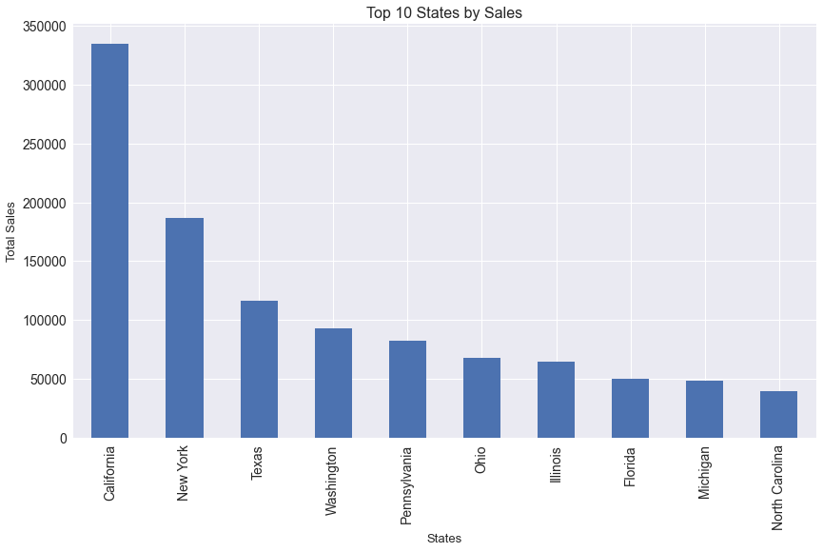
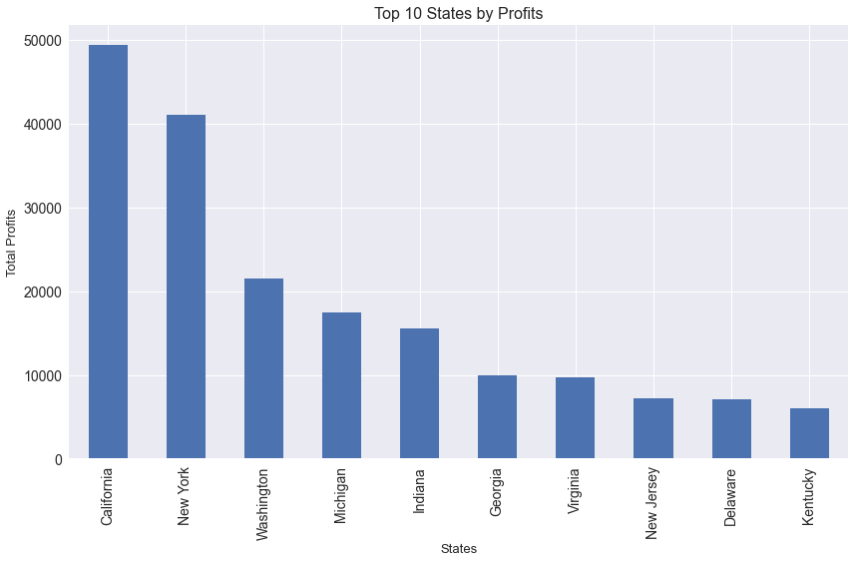
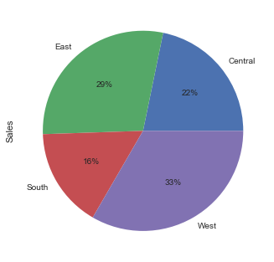
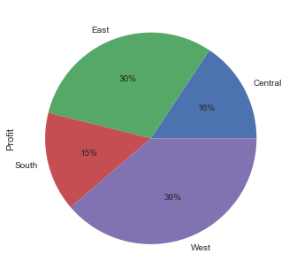
ANALYSIS
Profit by region
Sales by region

Slide 11
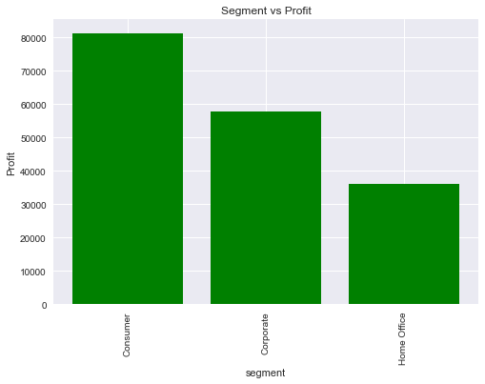
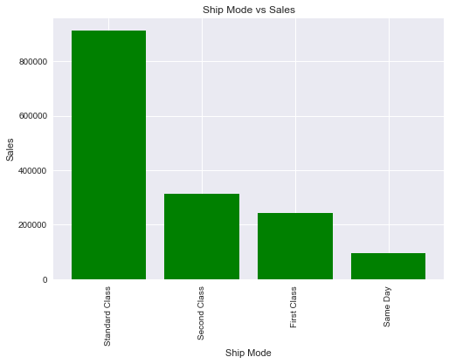
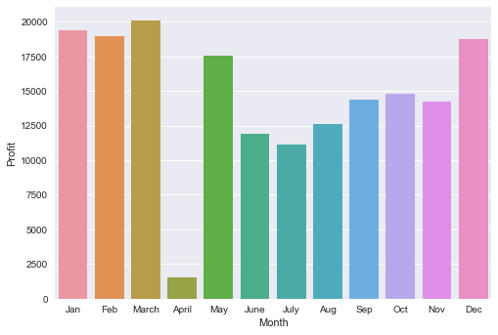
Profit by Month

Slide 12
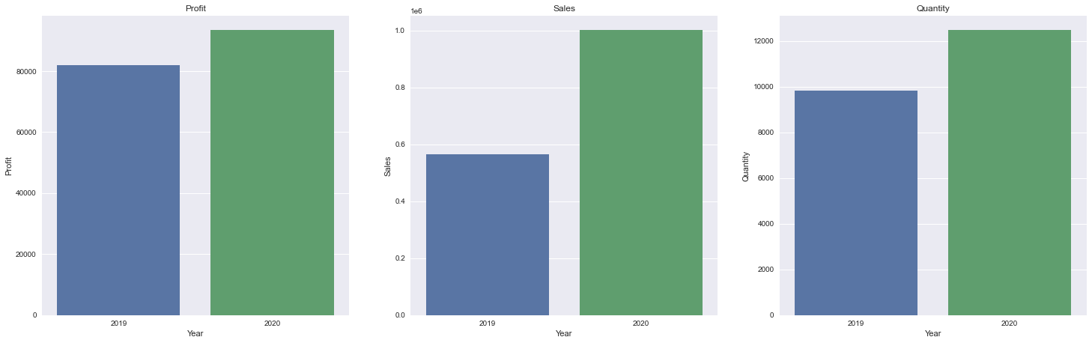

Slide 13
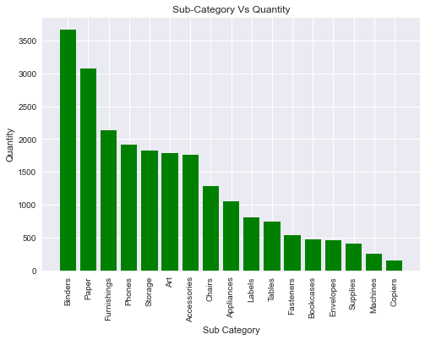
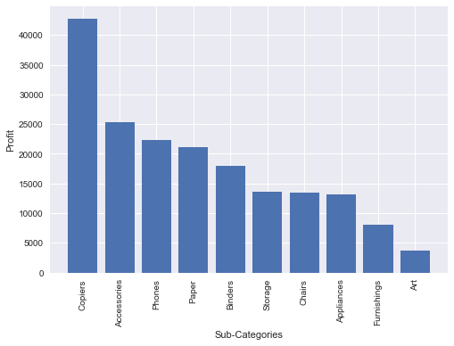
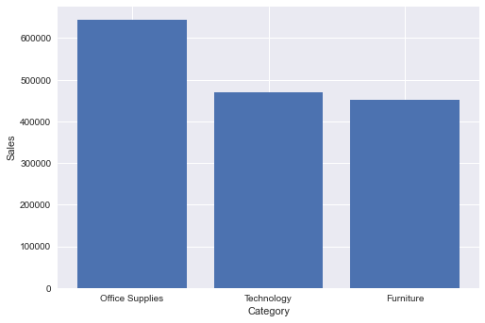
Profit by Sub-Category
Sales by Category

Slide 14
Results
Selling bookcases and tables result in huge losses, so super store has to consider to bundle them together with high selling or profitable sub-category such as chairs, copiers, phones and office supplies products.
Out of top 10 states. Most sales & profit were done in ‘california’ followed by ‘new york’. So, the company should focus on above 2 states to make most profit and most quantity sales are done there only.
Most sales and profit were made in ‘west’ region followed by ‘east’.
‘Consumer’segment made the most sales and profit as compared to ‘corporate’ and ‘home office’segments.
In ‘technology’ category business we get more profit as compared to other two business. These is because of less discount. So, we should shift focus on ‘furniture’ category due to less profit and more discount.
We must concentrate on the sales & profit of ‘arizona’ , ‘colorado’ , ‘north carolina’ , ‘ohio’ , ‘texas’states.
In ‘ship mode’analysis, most value was made on ‘standard class’ but the most sales were made on ‘same day’ and ‘second class’. Most profit was made on ‘first class’ followed by ‘second class’ .
Similarly, most quantity was transported in ‘second class’ & ‘standard class’ and most discount were given in ‘first class’ followed by ‘standard class’ .
Hence, to get good profit in any business you must focus on increasing sales but not giving more discount.

Slide 15
links
GitHub Link:
Reference:
https://github.com/Bisakha88/SuperStore_data_analytics.git
https://medium.com/analytics-vidhya/exploratory-data-analysis- super-store-cb91c37bcb06
https://github.com/alairdata/Superstore_Analysis
https://github.com/Sachinnavgale/-The-Spark-Foundation-Task

